Slide 1
Digital Principles and
Computer Organization

Slide 2
Digital Principles and Computer
Organization
Text Books:
Digital Logic and Computer Design, M. Morris Mano, 5th edition, Pearson publication, 2012.
Computer Organization, Carl Hamacher, Zvonko Vranesic, Safwat Zaky, 5th edition, TATA McGraw Hill, 2011.

Slide 3
Unit - I
Binary Systems
and
Boolean Algebra

Slide 4
Contents:
Number system
Number conversion
Complements and Binary Codes
Boolean Algebra – theorems & functions
Digital Logic gates
Logic circuits

Slide 5
NUMBER SYSTEMS
A number system is a code that uses symbols to refer to a number of items.
In any number system there is an ordered set of symbols known as digits with rules defined for performing arithmetic operations like addition, subtraction, multiplication, division etc.
A collection of these digits make a number .
In general It has two parts- integer and fraction.

Slide 6
NUMBER SYSTEM
Decimal
Binary
Octal
Hexadecimal

Slide 7
Introduction:
In every day life we use Decimal number system
A digital system is normally designed for two state operation. Hence uses Binary number system.
In addition to binary system, other system like Octal and Hexadecimal system are also used.
Digital computers and microprocessors uses Hexadecimal and Octal number system.

Slide 8
1. Decimal Number System
The word decimal is a derivative of decem, which is the Latin word for ten.
Numbers today are almost universally written
in a form of notation known as positional
number representation.
A number is represented as a string of digits.

Slide 9
Decimal Number Systems…
In a decimal number there are ten such digits
that may be used, ranging in value from 0 to 9.
Decimal numbers are positional numbers that have a base or radix of 10.
Why ten ?

Slide 10
Decimal Number Systems…
Exactly ten distinct numerals in order to
represent all possible values for each position in
the number, and hence to enable us to represent
all possible integer numbers in decimal notation.
0, 1, 2, 3, 4, 5, 6, 7, 8, and 9 values
For example, a number like "0123456789" has ten positions and each position can contain the digits 0-9.

Slide 11
Decimal Number Systems
Each digit position has a weight associated
with it.
Each digit corresponds to a power of 10 based on its position in the number
Number’s value = a weighted sum of the digits

Slide 12
Decimal Number Systems
Number’s value = a weighted sum of the digits
Number’ value = digit * 10^{x} + digit * 10^{x} where x = (position number - 1).
It sounds complicated ?

Slide 13
Decimal Number Systems
The powers of 10 increment from 0, 1, 2, etc. as you move right to left
Hundreds | Tens | Units
10² | 10¹ | 10⁰

Slide 14
Decimal Number Systems
The BASE is 10 or Dec or simply D
BASE = 10
10 ³
10³=1000
10²=100
10¹=10
10⁰=1
Power or Exponent
Base 10

Slide 15
Decimal Number Systems
Example:1
1234₁₀ = 1x 10³ + 2x 10² + 3x10¹ +4x10⁰
= 1000 + 200 + 30 + 4
= 1234₁₀

Slide 16
Decimal Number Systems
Example: 2
9876₁₀ = 9x 10³ + 8x 10² + 7x10¹ +6x10⁰
= 9000 + 800 + 70 + 6
= 9876₁₀

Slide 17
Decimal Number Systems
Summary
In the decimal system, there are 10 digits (0 through 9) which combine to form numbers as follows:
0 1 2 3 4 5 6 7 8 9 10 11 12 13 14 15 16 17 18 19 20 21 22 ...

Slide 18
BINARY NUMBER SYSTEM
Base 2 or radix 2.
Only two symbols are used to represent numbers in this system and these are 0 and 1. These are known as bits.
It is a positional system, i.e., every position is assigned a specific weight.

Slide 19
Binary Number Systems
Binary DigiTs (BITs) can be represented
electronically:
… 0 (no signal)
… 1 (signal)

Slide 20
Binary Number Systems…
All the information in the digital computer is represented as bit patterns
What is a bit pattern?
01010101
This is called as the bit pattern
This is one bit

Slide 21
Binary Number Systems…
Look at this bit pattern
0101 0101
How many bits are present ?
Count the number of ones and the zeros in the above pattern
Answer = Total 8 bits

Slide 22
Binary Number Systems
0101 0101
This pattern is represented as follows in the digital computer
Bit7 | Bit 6 | Bit 5 | Bit 4 | Bit 3 | Bit 2 | Bit 1 | Bit 0
0 | 1 | 0 | 1 | 0 | 1 | 0 | 1

Slide 23
Binary Number Systems
Bit7 | Bit 6 | Bit 5 | Bit 4 | Bit 3 | Bit 2 | Bit 1 | Bit 0
0 | 1 | 0 | 1 | 0 | 1 | 0 | 1
There are 8 bits in the above table
Group of 4 bits = 1 Nibble
Group of 8 bits = 1 Byte
Group of 16 bits = 1 Word ; 2 Bytes = 1 Word

Slide 24
Binary Number Systems
Bit7 | Bit 6 | Bit 5 | Bit 4 | Bit 3 | Bit 2 | Bit 1 | Bit 0
0 | 1 | 0 | 1 | 0 | 1 | 0 | 1
Bit 0 is called the Least Significant Bit LSB
Bit 7 is called the Most Significant Bit MSB

Slide 25
Binary Number Systems
A single bit can represent two states: 0 1
Therefore, if you take two bits, you can use them to represent four unique states:
00, 01, 10, & 11
And, if you have three bits, then you can use them to represent eight unique states:
000, 001, 010, 011, 100, 101, 110, & 111

Slide 26
Decimal To Binary
Decimal | Binary
0 | 0
1 | 1
2 | 10
3 | 11
4 | 100
5 | 101
6 | 110
7 | 111
Decimal | Binary
8 | 1000
9 | 1001
10 | 1010
11 | 1011
12 | 1100
13 | 1101
14 | 1110
15 | 1111

Slide 27
Binary Number Systems
Bit positions and their values
Bit7 | Bit 6 | Bit 5 | Bit 4 | Bit 3 | Bit 2 | Bit 1 | Bit 0
2⁷ | 2⁶ | 2⁵ | 2⁴ | 2³ | 2² | 2¹ | 2⁰
128 | 64 | 32 | 16 | 8 | 4 | 2 | 1

Slide 28
Place Value in the binary number System
Example: 1101.11
Place Value → 8s 4s 2s 1s
Binary Num → 1 1 0 1 . 1 1
Positional → 2³ 2² 2¹ 2^{0 .} 2⁻¹ 2⁻²

Slide 29
1.Binary to Decimal Conversion
Ex1: Convert 11011₂ into equivalent decimal number
11011 = 1x2⁴ + 1x2³ + 0x2² + 1x2¹+ 1x2⁰
= 16 + 8 + 0 + 2 + 1
= 27₁₀

Slide 30
Ex2. (101101.10101)₂ = ( )₁₀
10 1101 . 10101 this can be written as,
=1x2⁵ + 0x2⁴ + 1x2³ + 1x2²+ 0x2¹+ 1x2⁰+ 1x2⁻¹ + 0x2⁻² + 1x2⁻³ + 0x2⁻⁴ + 1x2⁻⁵
= 32 + 8 + 4 + 1 + 0.5 + 0.125 + 0.03125
= 45 + 0.65625
= (45.65625)₁₀

Slide 31
2. Decimal to Binary Conversion
Decimal numbers can be easily converted to binary numbers by repeatedly dividing the decimal numbers by 2,
The remainder after each division is used to indicate the coefficients of the binary number to be formed.
Then the binary number derived is written from bottom up.

Slide 32
Decimal to Binary Conversion
Example: (125)₁₀ = ( ) ₂
125 ÷ 2 = 62 + remainder of 1
62 ÷ 2 = 31 + remainder of 0
31 ÷ 2 = 15 + remainder of 1
15 ÷ 2 = 7 + remainder of 1
7 ÷ 2 = 3 + remainder of 1
3 ÷ 2 = 1 + remainder of 1
1 ÷ 2 = 0 + remainder of 1
(125)₁₀ = (1111101) ₂

Slide 33
Decimal to Binary Conversion
(0.625)₁₀ = ( .101 )₂
Fraction (F) | Product=F*2 | Integer part of product
0.625 | 1.250 | 1
0.250 | 0.500 | 0
0.50 | 1.000 | 1

Slide 34
Decimal to Binary Conversion
Ex:
(125. 625)₁₀ = (1111101.101) ₂
Convert the following to binary form:
(13)₁₀
(37)₁₀
(64)₁₀
(0.348)₁₀

Slide 35
OCTAL NUMBER SYSTEM
The octal number system has a base of 8.
Eight different symbols are used to represent numbers.
Symbols → 0,1,2,3,4,5,6 and 7.

Slide 36
1.Octal to Decimal number
We use the same method as used in the binary case, except that we now have a radix of 8 instead of 2 (in binary).
Example--- (1213)₈ ₌ ( )₁₀
=1x8³+2x8²+1x8¹+3x8°
= 512 + 128+8+3
=(651)_{10.}

Slide 37
Octal Number Systems
Repeated Division by 8
Example
213₁₀ = ( )₈ ?
Divide-by -8 | Quotient | Remainder | Octal digit
213 / 8 26 / 8 3 / 8 | 26 3 0 | 5 2 3 | Lower digit = 5 Second digit =2 Third digit =3
Answer = 325₈

Slide 38
Octal Number Systems
How to convert 325₈ back to Decimal ?
Use this table and multiply the digits with the position values
Digit 8 | Digit 7 | Digit 6 | Digit 5 | Digit 4 | Digit 3 | Digit 2 | Digit 1
8⁷ | 8⁶ | 8⁵ | 8⁴ | 8³ | 8² | 8¹ | 8⁰
…… | …… | 32768 | 4096 | 512 | 64 | 8 | 1

Slide 39
Octal Number Systems
How to convert 325₈ back to Decimal ?
Consider the above number
3 2 5 ₍₈₎
3 x 8² + 2 x 8¹ + 5 x 8⁰ = 3 x 64 + 2 x 8 + 5 x 1
= 192 +16 + 5
= 213
Digit 1
Digit 3
Digit 2

Slide 40
4.Decimal to Octal number
Conversion of decimal to octal can be performed by repeatedly dividing the decimal number by 8 and using each reminder as a digit in the octal number being formed.
For example to convert (200)₁₀ to an octal representation we divide as follows.
200 ÷ 8= 25 remainder is 0
25 ÷ 8= 3 remainder is 1
3 ÷ 8= 0 remainder is 3
Therefore (200)₁₀ = (310)₈

Slide 41
Decimal to Octal number
Notice that when the number to be divided is less than 8, we use 0 as the quotient and the number as the remainder.
Convert (0.513)₁₀ to Octal.
Ans…(0.406517)₈

Slide 42
5.Binary to Octal number
There is a simple trick of converting a binary number to an octal number.
Simply group the binary digits into groups of 3,
Starting at the octal point and read each set of 3 binary digits according to the following table.

Slide 43
Octal to binary
Octal | Binary
0 | 000
1 | 001
2 | 010
3 | 011
4 | 100
5 | 101
6 | 110
7 | 111

Slide 44
Binary to Octal number
Let us convert the binary number 011101.
First we break it into 3’s (thus 011 101).
Then converting each 3 binary digits and we get 35 in octal.
Therefore (011101)₂= (35 )₈.

Slide 45
6.Octal number to Binary
(67)₈=(110 111)₂
( 760512.403)₈ =(111110000101001010.100000011)₂

Slide 46
HEXADECIMAL NUMBER SYSTEM
The Hexadecimal number system has a base of 16
Sixteen different symbols are used to represent numbers.
The digits 0 to 9 , A, B, C, D, E , F are used.
The following table lists the binary and hexadecimal equivalent of decimal numbers 0 through 15.

Slide 47
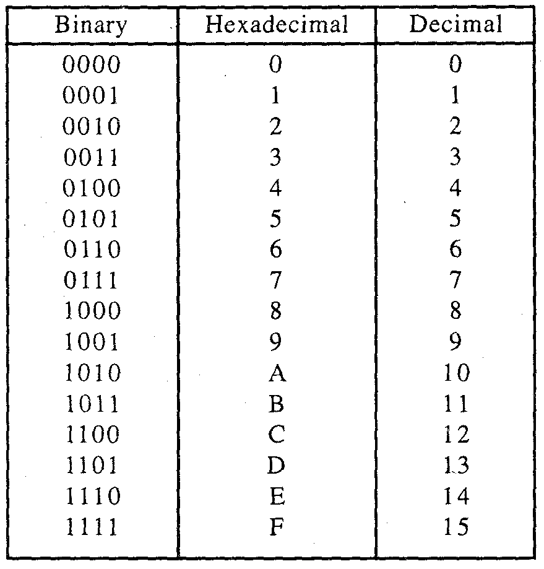

Slide 48
7. Binary to Hexadecimal
Break a binary number into groups of 4 bits and convert each group of 4 bits into hexa-decimal digit.
Examples
(10111011)₂ = (BB)₁₆
(10010101)₂= (95)₁₆
(11000111)₂= (C7)₁₆

Slide 49
8.Hexadecimal to Binary
(ABCD)₁₆=(1010101111001101)₂
(2309.7A)₁₆
=(0010001100001001.01111010) ₂

Slide 50
9.Hexadecimal to Decimal
This is straight forward but time consuming.
Example: (BB)₁₆ represents
=Bx16¹+Bx16°
=11x16+11x1
=176+11
=(187)₁₀
Similarly (AB6)₁₆=Ax16² + Bx16¹ + 6x16°
=10x256 + 11x16 + 6
=2560 + 176 + 6
=(2742)₁₀

Slide 51
Bits, Bytes, Nibbles and Word Size
Bit(1)--- The bit is the smallest unit (0 or 1)of data in a digital system.Binary digit.
Byte(8) ----Binary term , 8-bit group of data.
Nibble(4)--- A half-byte or a 4-bit group of data.

Slide 52
COMPLEMENTS
Complements are used in digital computers for simplifying the subtraction operations and for logical manipulation.
here are two types of complements for each base-r system.
(1) The r’s complement and
(2) The (r-1)’s complement.

Slide 53
The 9’s Complement
To perform 9’s complement of decimal number, each digit of a decimal number we subtract with 9 and the result obtained is called 9’s complement.
Ex: 9’s complement of (37)₁₀
99
-37
62 is the 9’s complement

Slide 54
The 10’s Complement
The 10’s complement of number is equal to 9’s complement of the number +1.
i.e, add 1 to 9’s complement to get 10’s complement.
Ex: find 10’s complement of (37)₁₀
99
-37
62
+1
63 is 10’s complement

Slide 55
1’s Complement
The 1’s complement of a given number is obtained by complementing each bit in the number.
All 1’s are changed to 0’s and 0’s to 1’s.
Ex: 1’s complement of 110010 is 001101

Slide 56
2’s Complement
2’s complement of given binary number is obtained by first finding the 1’s complement of given number and then add 1 to it.
Ex: 110010
1’s complement is 001101 +1= 001110

Slide 57
Subtraction using 1’s complement
Subtraction of binary numbers can be performed using 1’s complement which allows the use of addition process.
Procedure:
1’s complement of subtrahend is obtained.
Minuend is added with 1’s complement of subtrahend.
If result generated a carry then 1 is added to result and carry is discarded.

Slide 58
Alternatively it is also considered as “end around carry’. Which is added to result. Then difference obtained out of subtraction is positive.
4. If result doesnot generate carry then difference is negative and result is represented in its 1’s complement.
Ex: 1101 – 1001
1’s complement of 1001 is 0110
Then 1101+0110=10011
0011+1= 0100

Slide 59
Subtraction using 2’s complement
Procedure:
2’s complement of subtrahend is obtained.
Minuend is added with 2’s complement of subtrahend.
If the result generates a carry, then it indicates difference obtain is positive number. The carry is discarded.
If result does not generate carry, then it indicates difference obtained is negative number, the negative is represented in its 2’s complement form.

Slide 60
Binary codes
In coding, when numbers, letters or words are represented by a specific group of symbols, it is said that they are being encoded.
The group of symbols is called as a code.
The digital data is represented, stored and transmitted as group of binary bits. This group is also called as binary code.
The binary code is represented by the number as well as alphanumeric letter.

Slide 61
Classification of binary codes
The codes are broadly categorized into following four categories.
Weighted Codes
Non-Weighted Codes
Binary Coded Decimal (BCD) Code
Alphanumeric Codes

Slide 62
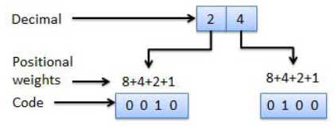
1. Weighted Codes
Weighted binary codes are those binary codes which obey the positional weight principle.
Each position of the number represents a specific weight. Several systems of the codes are used to express the decimal digits 0 through 9. In these codes each decimal digit is represented by a group of four bits.

Slide 63

2. Non-Weighted Codes
In this type of binary codes, the positional weights are not assigned.
For examples: Excess-3 code and Gray code.
Excess-3 code

Slide 64
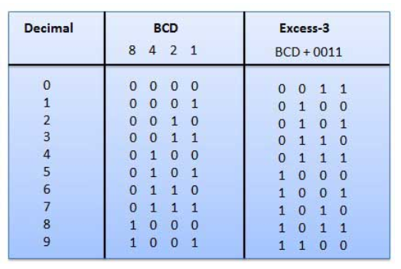


Slide 65
Gray Code
It is the non-weighted code and it is not arithmetic codes. That means there are no specific weights assigned to the bit position.
It has a very special feature that, only one bit will change each time the decimal number is incremented as shown in fig.
As only one bit changes at a time, the gray code is called as a unit distance code. The gray code is a cyclic code. Gray code cannot be used for arithmetic operation.

Slide 66
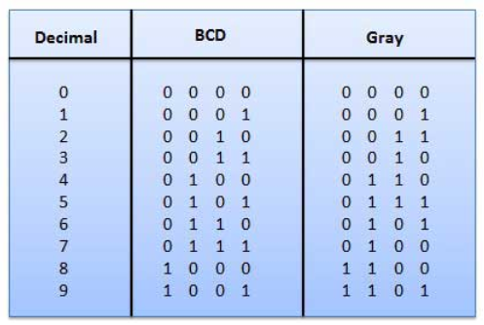

Slide 67
3. Binary Coded Decimal (BCD) code
In this code each decimal digit is represented by a 4-bit binary number.
BCD is a way to express each of the decimal digits with a binary code.
In the BCD, with four bits we can represent sixteen numbers i.e.,0-15 (0000 to 1111).
But in BCD code only first ten of these are used (0000 to 1001). The remaining six code combinations i.e. 1010 to 1111 are invalid in BCD.

Slide 68
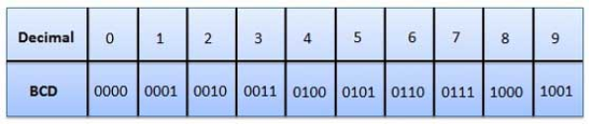

Slide 69
4. Alphanumeric codes
A binary digit or bit can represent only two symbols as it has only two states '0' or '1'.
But this is not enough for communication between two computers because there we need many more symbols for communication. These symbols are required to represent 26 alphabets with capital and small letters, numbers from 0 to 9, punctuation marks and other symbols.
The alphanumeric codes are the codes that represent numbers and alphabetic characters.

Slide 70
An alphanumeric code should at least represent 10 digits and 26 letters of alphabet i.e. total 36 items.
The following alphanumeric codes are very commonly used for the data representation.
  American Standard Code for Information Interchange (ASCII).
  Extended Binary Coded Decimal Interchange Code (EBCDIC).
  ASCII code is a 7-bit code whereas EBCDIC is an 8-bit code.

Slide 71
End of Chapter 1: Binary System

Slide 72
Chapter 2: Boolean Algebra
Logic gates and circuits

